Slide 1
Java Servlet Container
JavaEE-2019

Slide 2
Contents
JavaEE Architecture
How does Java Servlet Container work?

Slide 3
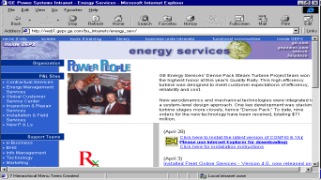
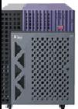
Server Side Development Tiered Architecture
The owl two-tiered client-erver model has been superceded by the multi-tiered architecture prevelant in the enterprise applications
Allows each layer to communicate just with layers above and below it
Benefits of having a tiered application
Encapsulates rules and functionality together providing for easier maintenance & development
Enhances flexibility and reusability of logic and software components
Allows developers to focus on the area of their speciality e.g. database, servers, web page, etc.
Application/Browser
(User Interface)
Web Server
(Application Logic)
Database/ FileSystem
(Persistent Storage)

Slide 4
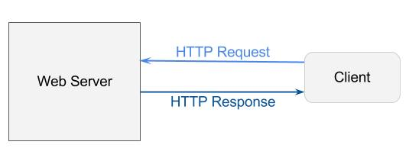
Server Side Development Web Server
A web server is a program running on the server that listens for incoming requests and services those requests as they come in.
Once the web server receives a request, depending on the type of request the web server might look for a web page, or it might execute a program on the server.
It will always return some kind of results to the web browser, even if its simply an error message saying that it couldn’t process the request.
By default the role of a web server is to serve static pages using the http protocol
Web servers can be made
dynamic by adding additional
processing capability to the server

Slide 5
JavaEE Architecture JavaEE – Container Architecture
Application is considered as a collection of related yet independent components
Container acts as an execution environment for the components
Container Provides services to the components
J2EE Container
J2EE Component
Component Code
& Resources
J2EE
Component
J2EE
Component
J2EE
Component
J2EE
Component
Component 2

Slide 6
JavaEE Architecture JavaEE – Container Architecture, cont’d.
Client Tier
3rd & Nth Tiers
Applet Container
Applet
Application Container
Middle Tier
Application
J2EE Server
Database
JDBC
JAXP
JAAS
J
M
S
internet
Web Container
Web Container
internet
Servlets
JSPs
EJBs
Enterprise Information System
J2EE Server
JAXP
JAXP
JAAS
Connections
JAAS
Connections
JMS
JDBC
JDBC
JavaMail/JAF
JTA
JavaMail/JAF
JMS
JTA
J2EE Server
J2ME App
Non-Java Sever
Other Application or Server

Slide 7
JavaEE Architecture Middle Tier Container
Web Container
Manages execution of servlets and JSPs
Part of web or application server
Supports HTTP
EJB Container
Business Components that contain business logic or rules
Two types of EJBs
Session Beans – Logic Oriented and deal with handling client requests and data processing
Entity Beand – Strongly coupled with data and deal with data access and persistence

Slide 8
JavaEE Architecture E-Commerce Scenario
WEB Container
J2EE Server
WEB Container
Shopping Cart Application
WEB Container
Catalog Servlet
WEB Container
Application Container
OrderManager Application
Supplier Server
Cart Servlet
StockOrder
(XML)
Order
ClientApp
Process Servlet
Order Manager
Servlet
Static
Pages
EJB Container
WEB Container
Order Manager EJBApplication
Database
Order EJB
Two distinct parts of the applications
Shopping Cart: Handles consumer side of the store
Order Manager: Handles back end processing

Slide 9
JavaEE Architecture E-Auctions
Client Tier
Browser
Applet Container
PaymentApplet
Middle Tier
Sales & Auction Cluster
Payment Cluster
WEB Container
WEB Container
WEB Container
WEB Container
WEB Container
WEB Container
WEB Container
WEB Container
WEB Container
WEB Container
Sales/Auction
Application
Sales/Auction
Application
Sales/Auction
Application
Payment
Application
Payment
Application
Database Tier
Sales & Auction Database
Payment Database

Slide 10
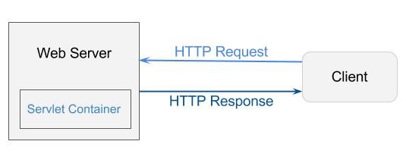
What is a Servlet Container?
As Web Server can only response with static web page
The basic idea of Servlet container is using Java to dynamically generate the web page on the server side. So servlet container is essentially a part of a web server that interacts with the servlets.
Servlet container is the container for Servlets.

Slide 11
Servlet Interface
Servlet is an interface defined in javax.servlet package.
It declares three essential methods for the life cycle of a servlet – init(), service(), and destroy().
They are implemented by every servlet(defined in SDK or self-defined) and are invoked at specific times by the server.

Slide 12
Servlet Interface
The init() method is invoked during initialization stage of the servlet life cycle. It is passed an object implementing the javax.servlet.ServletConfig interface, which allows the servlet to access initialization parameters from the web application.
The service() method is invoked upon each request after its initialization. Each request is serviced in its own separate thread. The web container calls the service() method of the servlet for every request. The service() method determines the kind of request being made and dispatches it to an appropriate method to handle the request.
The destroy() method is invoked when the servlet object should be destroyed. It releases the resources being held.

Slide 13
How Servlet work
From the life cycle of a servlet object, servlet classes are loaded to container by class loader dynamically. Each request is in its own thread, and a servlet object can serve multiple threads at the same time(thread not safe). When it is no longer being used, it should be garbage collected by JVM.
To handle the complexity of HTTP requests, the servlet container comes in. The servlet container is responsible for servlets’ creation, execution and destruction.

Slide 14
How Servlet container and web server process a request?
Web server receives HTTP request
Web server forwards the request to servlet container
The servlet is dynamically retrieved and loaded into the address space of the container, if it is not in the container.
The container invokes the init() method of the servlet for initialization(invoked once when the servlet is loaded first time)
The container invokes the service() method of the servlet to process the HTTP request, i.e., read data in the request and formulate a response. The servlet remains in the container’s address space and can process other HTTP requests.
Web server return the dynamically generated results to the correct location

Slide 15
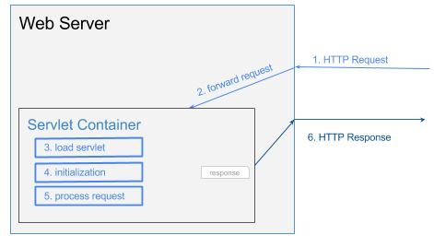
How Servlet container and web server process a request?
Web server receives HTTP request
Web server forwards the request to servlet container
The servlet is dynamically retrieved and loaded into the address space of the container, if it is not in the container.
The container invokes the init() method of the servlet for initialization(invoked once when the servlet is loaded first time)
The container invokes the service() method of the servlet to process the HTTP request, i.e., read data in the request and formulate a response. The servlet remains in the container’s address space and can process other HTTP requests.
Web server return the dynamically generated results to the correct location

Slide 16
Servlets Servlet Lifecycle
Servlet Container
Create Thread Pool
Thread
Thread
Instantiate servlet
Servlet
Call init ( ) method
Perform Initialization
HTTP Request 1
Call service ( ) method
Allocate request to thread
HTTP Request 2
Call service ( ) method
Allocate request to thread
Perform Service
Shutdown Initiated
Block all further requests Wait for active threads to end
Perform Service
HTTP Response 1
Terminate thread pool
HTTP Response 2
call destroy ( ) method
Perform cleanup
terminate servlet
Servlet destroyed & garbage collected
Container shutdown

Slide 17
Servlets Introduction
Classes that dynamically process requests and construct responses
Dynamically generate html pages in response to requests
May also send data in other forms like XML or serialized Java objects
Run in a servlet container and have access to services that the container provides
In an application processing of each request will normally be done by a different servlet.
e.g. search catalog, check out, confirm order etc.

Slide 18
Servlet Implementation
Eclipse
Tomcat/Jetty
Maven
Refer to the example: simpleservlet project

Slide 19
Conclusion
Using servlets allows the JVM to handle each request within a separate Java thread, and this is one of the key advantage of Servlet container.
Each servlet is a Java class with special elements responding to HTTP requests.
The main function of Servlet contain is to forward requests to correct servlet for processing, and return the dynamically generated results to the correct location after the JVM has processed them.
In most cases servlet container runs in a single JVM, but there are solutions when container need multiple JVMs.

Slide 20
The End

